Slide 1
Listening

Slide 2
PRACTICE 1: Time
First, listen to the audio. You’ll hear six sentences spoken.
Write the time you hear.
The express train leaves at 9.30 a.m.
The best option would be to take the 7:06 bus.
There are two buses that will get you there, one just before 9 o’clock and one just after.
The 8:55 is probably the best one to take.
I think I’ll catch the 5 to 9 bus. (➔ 8.55)
There is also a train departing at a quarter to nine. (➔ 8.45)

Slide 3
PRACTICE 2: Numbers
Numbers can come up in many different contexts so make sure that you know how they sound and how to write them. It can be difficult to understand some numbers in certain accents. So, listen to them in a range of accents as you practice your listening skills.
In all accents, teen and ten numbers sound very similar and are easily confused, e.g.
13 and 30 (thirteen and thirty)
14 and 40 (fourteen and forty)
15 and 50 (fifteen and fifty)
16 and 60 (sixteen and sixty)
17 and 70 (seventeen and seventy)
18 and 80 (eighteen and eighty)
19 and 90 (nineteen and ninety)
Write the numbers you hear.
1. 18/80 18
2. 15/50 50
3. 16/60 60
4. 13/30 13
5. 14/40 40

Slide 4
PRACTICE 3: Prices
Another common way that numbers are used in the listening test is as prices.
Write the prices you hear.
1. £4.35 four pounds thirty-five
2. $6.50 / $3.25 six dollars fifty / three dollars twenty-five cents
3. £15.75 fifteen euros seventy-five

Slide 5
PRACTICE 4: Dates
Write the dates you hear.
1) 18th June 1815 // June 18 1815 // 18/6/1815
2) 17th December 2019 // December 17 2019 // 17/12/19
3) 21st July // July 21 // 21/7

Slide 6
PRACTICE 5: Letters
Write the letters you hear.
1. Beardman
2. Drapersville

Slide 7
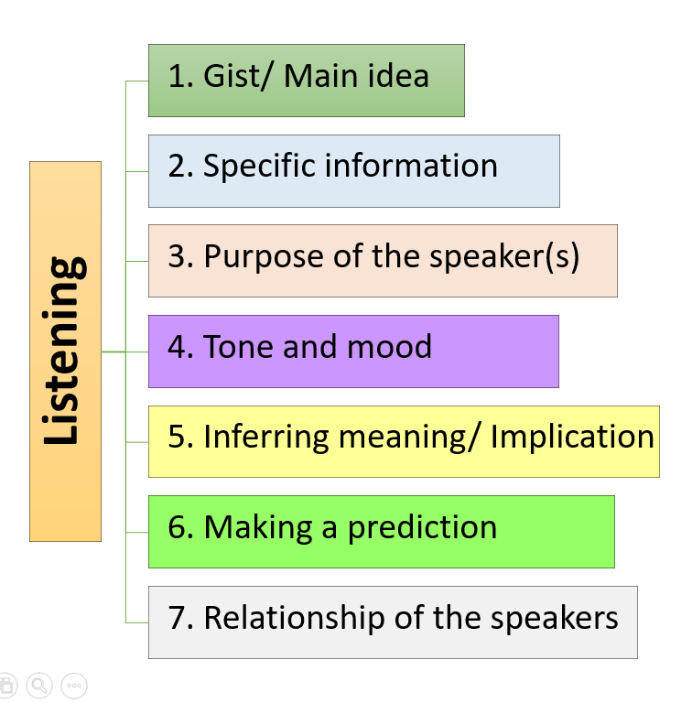
Track 1
1. What is the man’s name?
(A) Jacob McKre
(B) Jacob Mackre
(C) Jacob Mkere
(D) Jacob Kekre
2. Where does the man want to pick up the package?
(A) Bristol College
(B) Bestall College
(C) Wistall College
(D) Westall College
3. What is the post code of the college?
(A) BS8 5PU
(B) BS8 9PU
(C) BF8 5PU
(D) BF8 9PU
4. What are the content of the package?
(A) Books and toys
(B) Books and coins
(C) Books, toys and coins
(D) Books, toys and clothes
5. How much does all stuff cost in total?
(A) 150
(B) 200
(C) 1500
(D) 1700
6. What is the conversation mainly about?
(A) The package sending
(B) The size of the package
(C) The address of the college
(D) The cost of the package sending
7. What is the tone of the woman in this conversation?
(A) Hopeful
(B) Supportive
(C) Encouraging
(D) Disappointed

Slide 8
1. What is the man’s name?
(A) Jacob McKre
(B) Jacob Mackre
(C) Jacob Mkere
(D) Jacob Kekre
2. Where does the man want to pick up the package?
(A) Bristol College
(B) Bestall College
(C) Wistall College
(D) Westall College
3. What is the post code of the college?
(A) BS8 5PU
(B) BS8 9PU
(C) BF8 5PU
(D) BF8 9PU
4. What are the content of the package?
(A) Books and toys
(B) Books and coins
(C) Books, toys and coins
(D) Books, toys and clothes
Track 1 (KEY)
5. How much does all stuff cost in total?
(A) 150
(B) 200
(C) 1500
(D) 1700
6. What is the conversation mainly about?
(A) The package sending
(B) The size of the package
(C) The address of the college
(D) The cost of the package sending
7. What is the tone of the woman in this conversation?
(A) Hopeful
(B) Supportive
(C) Encouraging
(D) Disappointed

Slide 9
Track 1_Script
You will hear a telephone conversation between a customer and an agent at a company which ships large boxes overseas.
A: Good morning Packham’s Shipping Agents. Can I help you?
B: Oh yes, I’m ringing to make enquiries about sending a large box, a container, back home to Kenya from the UK.
A: Yes, of course. Would you like me to try and find some quotations for you?
B: Yes, that’d be great. Thank you.
A: Well first of all, I need a few details from you.
B: Fine.
A: Can I take your name?
B: It’s Jacob Mkere.
A: Can you spell your surname, please?
B: Yes, it’s M-K-E-R-E.
A: Is that ‘M’ for mother?
B: Yes.
A: Thank you, and you say that you will be sending the box to Kenya?
B: That’s right.
A: And where would you like the box picked up from?
B: From college, if possible.
A: Yes, of course. I’ll take down the address now.
B: It’s Westall College.
A: Is that W-E-S-T-A-L-L?
B: Yes, ... college.
A: Westall College. And where’s that?
B: It’s Downlands Road, in Bristol.
A: Oh yes, I know it. And the postcode?
B: It’s BS8 9PU.
A: Right ... and I need to know the size.
B: Yes, I’ve measured it carefully and it’s 1.5m long ...
A: Right.
B: 0.75m wide ...
A: OK.
B: And it’s 0.5m high or deep.
A: Great. So I’ll calculate the volume in a moment and get some quotes for that. But first can you tell me, you know, very generally, what will be in the box?
B: Yes there’s mostly clothes.
A: OK. [writing down]
B: And there’s some books.
A: OK. Good. Um ... Anything else?
B: Yes, there’s also some toys.
A: OK and what is the total value, do you think, of the contents?
B: Well the main costs are the clothes and the books – they’ll be about £1500 but then the toys are about another two hundred – so I’d put down £1700.

Slide 10
Track 2
11. Which hotel is on the process of constructing the swimming pool and gym?
(A) The Royal Oak
(B) The Bridge Hotel
(C) The Majestic Hotel
(D) The Carlton House
12. What is the main idea of the passage?
(A) The man is asking the hotel for the direction.
(B) The man is booking the hotel in the city center.
(C) The man is asking about the details of the hotels.
(D) The man is requesting for the hotel’s swimming pool.
13. What is the tone of this conversation?
(A) Amused
(B) Indifferent
(C) Informative
(D) Disappointed
8. Why did the man mention having the car?
(A) To inspire the woman about driving
(B) To provide information about his car
(C) To confirm that the car is ready to drive
(D) To prove that he can choose many options
9. Which hotel is located in the city center?
The Imperial
The Royal Oak
The Bridge Hotel
The Majestic Hotel
10. How many hotels are close to the airport?
One
Two
Three
Four

Slide 11
Track 2 (KEY)
11. Which hotel is on the process of constructing the swimming pool and gym?
(A) The Royal Oak
(B) The Bridge Hotel
(C) The Majestic Hotel
(D) The Carlton House
12. What is the main idea of the passage?
(A) The man is asking the hotel for the direction.
(B) The man is booking the hotel in the city center.
(C) The man is asking about the details of the hotels.
(D) The man is requesting for the hotel’s swimming pool.
13. What is the tone of this conversation?
(A) Amused
(B) Indifferent
(C) Informative
(D) Disappointed
8. Why did the man mention having the car?
(A) To inspire the woman about driving
(B) To provide information about his car
(C) To confirm that the car is ready to drive
(D) To prove that he can choose many options
9. Which hotel is located in the city center?
The Imperial
The Royal Oak
The Bridge Hotel
The Majestic Hotel
10. How many hotels are close to the airport?
One
Two
Three
Four
8. D
9. A
10. B
11. C
12. C
13. C

Slide 12
Track 2_Script

Slide 13
Track 3
14. When is the deadline for making a decision about optional courses?
Next week
Next month
Next semester
Next year
15. How many optional courses that the student was required to choose?
Two
Three
Four
Five
16. What is the main focus of the “Woman and Power” course?
Woman’s education
Cultures related to women
Women throughout the history
Legal and social situation about women
17. Which course focus on the Britain revolutions?
Cultural theory
Woman and Power
Culture and Society
Identity and popular culture
18. What can be inferred about the man and his concept about learning history?
(A) A man is good at learning history.
(B) A man isn’t interested in the history subjects.
(C) A man would like to learn more about history.
(D) A man doesn’t have a good grade in history subject.
19. What is the conversation mainly about?
The courses that the students have already taken.
An important course that the students must enroll.
A variety of history courses that the students are able enroll.
The choices and the details of the courses that the students can enroll.
20. What do you think the man will do after the conversation?
Study the communication 102 course
Message the instructor about the decision
Discuss on the assignment with the teacher
Take every course suggested by the teacher
21. What is the relationship between the two speakers?
Advisor and students
History teachers and students
A course coordinator and students
Senior students and Junior students
22. What is the tone of the women in this conversation?
Amused
Optimistic
Encouraging
Disappointed

Slide 14
Track 3 (KEY)
14. When is the deadline for making a decision about optional courses?
Next week
Next month
Next semester
Next year
15. How many optional courses that the student was required to choose?
Two
Three
Four
Five
16. What is the main focus of the “Woman and Power” course?
Woman’s education
Cultures related to women
Women throughout the history
Legal and social situation about women
17. Which course focus on the Britain revolutions?
Cultural theory
Woman and Power
Culture and Society
Identity and popular culture
18. What can be inferred about the man and his concept about learning history?
(A) A man is good at learning history.
(B) A man isn’t interested in the history subjects.
(C) A man would like to learn more about history.
(D) A man doesn’t have a good grade in history subject.
19. What is the conversation mainly about?
The courses that the students have already taken.
An important course that the students must enroll.
A variety of history courses that the students are able enroll.
The choices and the details of the courses that the students can enroll.
20. What do you think the man will do after the conversation?
Study the communication 102 course
Message the instructor about the decision
Discuss on the assignment with the teacher
Take every course suggested by the teacher
21. What is the relationship between the two speakers?
Advisor and students
History teachers and students
A course coordinator and students
Senior students and Junior students
22. What is the tone of the women in this conversation?
Amused
Optimistic
Encouraging
Disappointed
14. A
15. A
16. C
17. C
18. B
19. D
20. C
21. A
22. C

Slide 15
Track 3_Script

